Slide 1
OPIM 5509 · MODULE 3.1
ConvNet Theory
and Terminology
Dr. Dave Wanik · Introduction to Deep Learning · University of Connecticut
Notes:
Video 2-3 of M3.1. PowerPoint time - rare for this class, but ConvNet concepts deserve pictures.

Slide 2
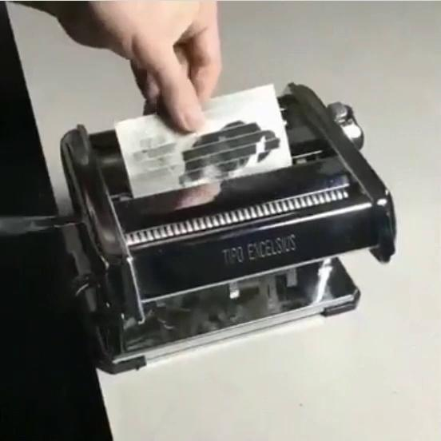
MODULE 3.1 · CONVNET THEORY
A ConvNet is a feature-making machine
An image goes in... and gets convolved into FEATURE MAPS
Each kernel highlights a different part of the image
Useful regions "light up" - ears, whiskers, textures
The model learns WHICH kernels help it predict
"Picture the conv layer as a pasta maker -
the dog comes out as feature maps."
- the hook from the 2022 lecture, still undefeated
OPIM 5509 · Introduction to Deep Learning
2
Notes:
The Steve Nouri GIF. Input dog -> pasta maker -> feature maps. Two kernels -> two maps, etc.

Slide 3
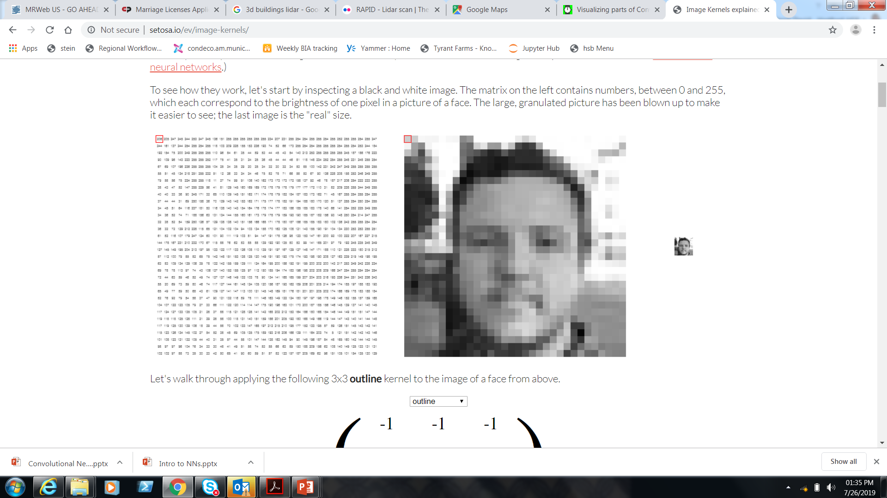
MODULE 3.1 · CONVNET THEORY
Images are data!
B&W image = one 2D array of 0-255. Color image = THREE stacked arrays (R, G, B channels). Pixels are just numbers - so it's all just math.
OPIM 5509 · Introduction to Deep Learning
3
Notes:
Grayscale 0-255, single channel. RGB = 3 channels. This is why input_shape has that last dimension.

Slide 4
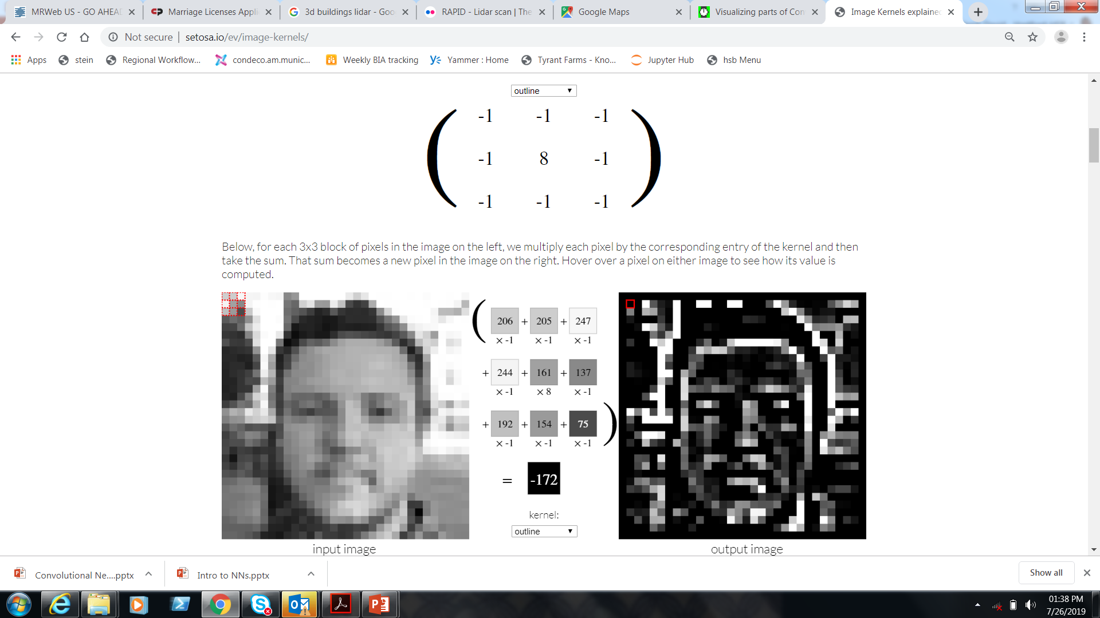
MODULE 3.1 · CONVNET THEORY
Kernels in action: outline
Constant kernel values - this one finds edges by amplifying differences between neighbors.
OPIM 5509 · Introduction to Deep Learning
4
Notes:
outline kernel demo. In OUR ConvNets the kernel values are LEARNED, not fixed like Photoshop.

Slide 5
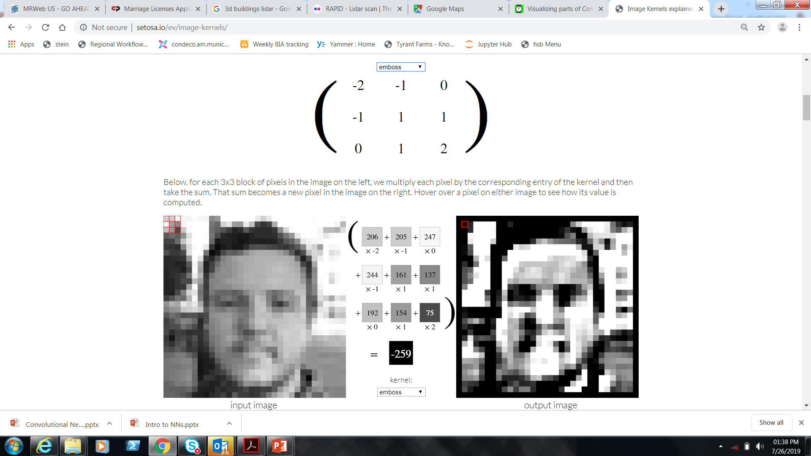
MODULE 3.1 · CONVNET THEORY
Kernels in action: emboss
Gives the illusion of depth - emphasizes pixel differences in one direction.
OPIM 5509 · Introduction to Deep Learning
5
Notes:
emboss kernel demo. In OUR ConvNets the kernel values are LEARNED, not fixed like Photoshop.

Slide 6
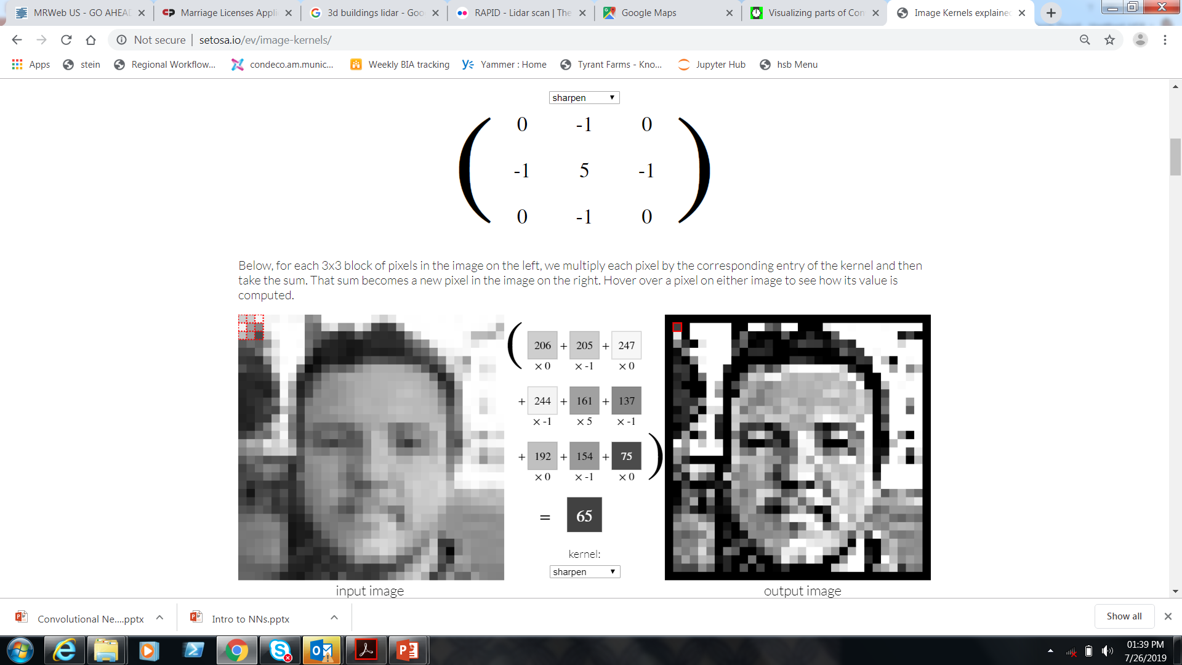
MODULE 3.1 · CONVNET THEORY
Kernels in action: sharpen
Amplifies the center pixel vs. its neighbors - the image "pops". Play live: setosa.io/ev/image-kernels
OPIM 5509 · Introduction to Deep Learning
6
Notes:
sharpen kernel demo. In OUR ConvNets the kernel values are LEARNED, not fixed like Photoshop.

Slide 7
MODULE 3.1 · CONVNET THEORY
Convolution: light downsampling
THE RULES
Kernel slides with a stride of 1
Lots of OVERLAP between steps
Output = feature map, slightly smaller
New size: L - (M - 1)
"Convolution is a light
downsampling of information."
- say it with me
OPIM 5509 · Introduction to Deep Learning
7
Notes:
Green = image, yellow = kernel, element-wise multiply + sum. 32x32 with 3x3 -> 30x30.

Slide 8
MODULE 3.1 · CONVNET THEORY
Pooling: aggressive downsampling
THE RULES
Stride = kernel size: NO overlap
Just takes the max in each window
New size: L / M (2x2 kernel halves it)
ZERO trainable parameters
"It flips over like a domino -
no overlap, nothing learned."
- max pooling in one line
OPIM 5509 · Introduction to Deep Learning
8
Notes:
4x4 -> 2x2 with a 2x2 kernel. Max or average - most people use max and move on.

Slide 9
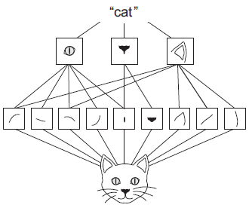
MODULE 3.1 · CONVNET THEORY
No more feature engineering!
1
INPUT DATA
raw pixels
2
LOWER-LEVEL FEATURES
edges, curves, colors
3
HIGHER-LEVEL FEATURES
ears, eyes, textures
4
MODEL PREDICTION
cat or dog?
Bonus: SPATIAL INVARIANCE - the cat can be anywhere in the frame. No more perfectly centered MNIST digits.
OPIM 5509 · Introduction to Deep Learning
9
Notes:
The network builds its own features. Early layers = boring edges; deep layers = object parts.

Slide 10
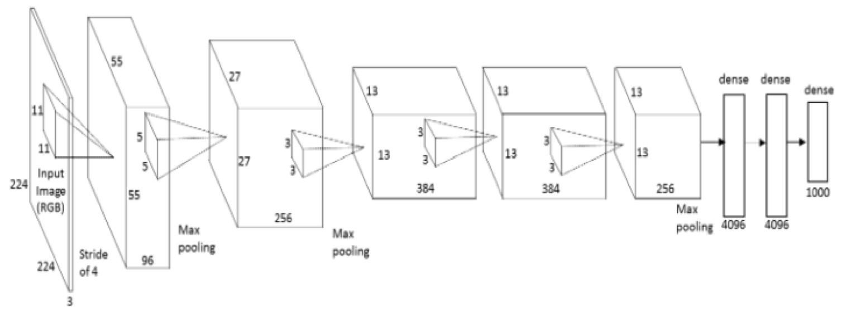
MODULE 3.1 · CONVNET THEORY
AlexNet: a famous ConvNet
Won ImageNet 2012 and kicked off the deep learning era. Look closely - it is just conv, pool, conv, pool... then dense.
OPIM 5509 · Introduction to Deep Learning
10
Notes:
Point at the stages. Millions of images, 1000 classes.

Slide 11
MODULE 3.1 · CONVNET THEORY
AlexNet = data prep + the NN you know
conv/pool stack = the DATA PREP we just learned
FLATTEN -> dense layers = the NN from Module 2!
OPIM 5509 · Introduction to Deep Learning
11
Notes:
Demystify: a ConvNet is feature-making front end + the dense network they already built.

Slide 12
MODULE 3.1 · CONVNET THEORY
Coming attraction: Cats vs. Dogs
MODULE 3.2
The "hello world" of computer vision
Real, messy images
Data augmentation
Image generators
OPIM 5509 · Introduction to Deep Learning
12
Notes:
Teaser for the implementation week.

Slide 13
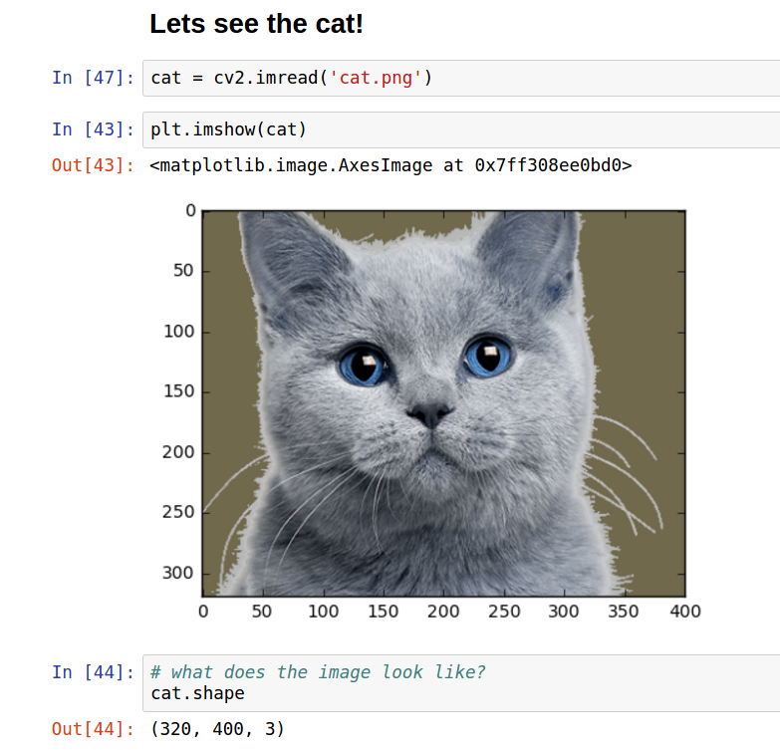
MODULE 3.1 · CONVNET THEORY
A color image = 3 channels
height 320 · width 400 · 3 channels
The R, G and B arrays stack like pages in a book. A kernel on RGB input is really an M x N x 3 brick - one slice per channel, summed into ONE feature map.
OPIM 5509 · Introduction to Deep Learning
13
Notes:
Sets up the L in the parameter formula - and why channels confuse everyone in layer 2.

Slide 14
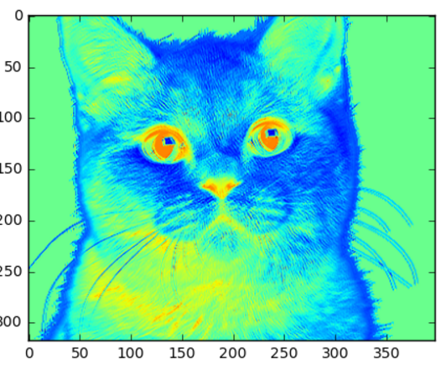
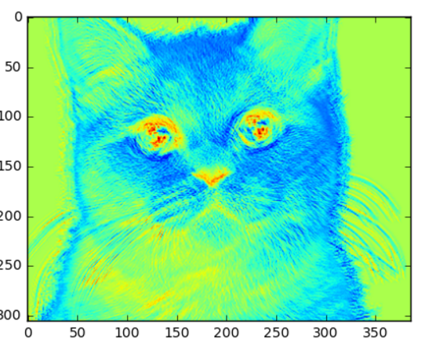
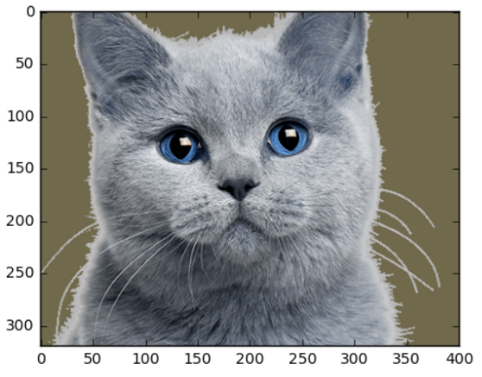
MODULE 3.1 · CONVNET THEORY
Filter size changes what you see
Original photo
3 x 3 filter: more detail, bigger map
15 x 15 filter: less detail, smaller map
OPIM 5509 · Introduction to Deep Learning
14
Notes:
One layer of convolution with different kernel sizes. Small kernel = fine detail.

Slide 15
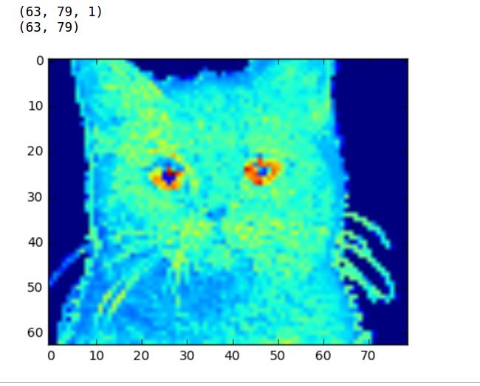
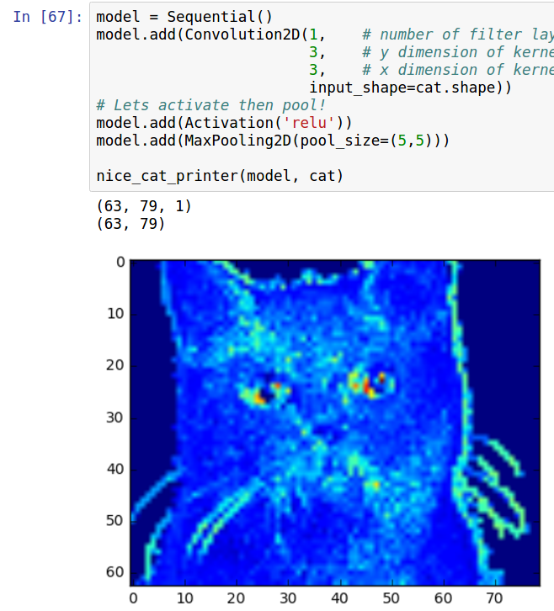
MODULE 3.1 · CONVNET THEORY
Pooling shrinks the feature map
Pooling layer (5 x 5)
ReLU + pooling layer (5 x 5)
You are welcome to put the ReLU activation right inside the Conv2D layer - check the docs.
OPIM 5509 · Introduction to Deep Learning
15
Notes:
63x79x1 examples from the blog.

Slide 16
MODULE 3.1 · CONVNET THEORY
Counting parameters: Conv2D
Conv2D trainable parms = ((M · N · L) + B) · F
M, N = filter size · L = channels coming INTO the layer · B = 1 bias per filter · F = feature maps created
Each filter is an M x N x L BRICK - one M x N slice of weights per input channel, summed into ONE output map
One bias per filter - the kernel and its bias slide together (just like one bias per output node in dense layers)
Example: L = 32 maps in, F = 64 maps out, 3 x 3 filter -> ((3 · 3 · 32) + 1) · 64 = 18,496 parameters
The L is the one that bites: deeper layers inherit L from the PREVIOUS layer's F.
OPIM 5509 · Introduction to Deep Learning
16
Notes:
Slow down here. The brick picture is the whole game for layer-2 param counts.

Slide 17
MODULE 3.1 · CONVNET THEORY
Counting parameters: everything else
INPUT LAYER
POOLING LAYER
0 parameters
0 parameters
it just reads the image
nothing is learned - it only shrinks the maps
DENSE LAYER
OUTPUT LAYER
(n + 1) · m
(n + 1) · m
n inputs, m outputs; the +1 is each output node's bias
it's just another dense layer
OPIM 5509 · Introduction to Deep Learning
17
Notes:
Pooling: zero. Dense: same formula as Module 2. No surprises.

Slide 18
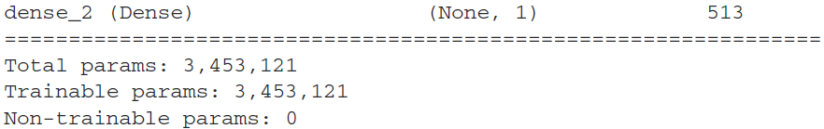
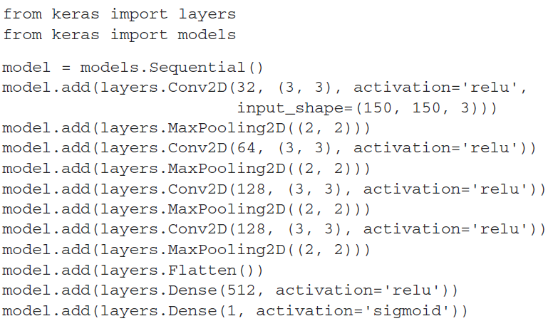
MODULE 3.1 · CONVNET THEORY
Check yourself against model.summary()
THE WORKFLOW
Read the code
Predict every output shape
Predict every param count
Run it - and check yourself
This is the exam question!
OPIM 5509 · Introduction to Deep Learning
18
Notes:
Bridge to the math deck + notebook where we do exactly this.

Slide 19
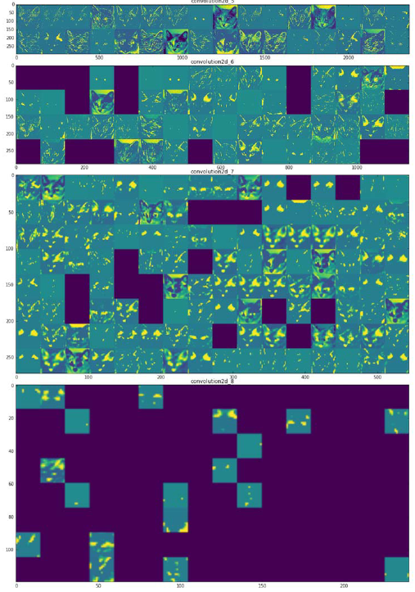
MODULE 3.1 · CONVNET THEORY
What do ConvNets learn?
Early convolutions: edges and blobs. Later convolutions: textures and object parts. Then FLATTEN -> dense classifier.
OPIM 5509 · Introduction to Deep Learning
19
Notes:
Read the figure left to right: one input image -> early convs -> later convs -> classifier.

Slide 20
A PEEK BEHIND THE CURTAIN
Advanced Topics
For later lectures - but let's stay motivated. This is where ConvNets get exciting.
Notes:
Teaser section - transfer learning comes in M3.3.

Slide 21
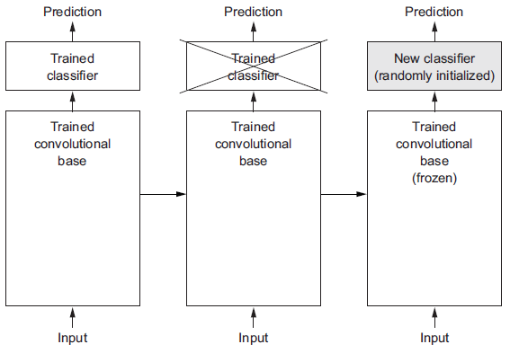
ADVANCED TOPICS · TRANSFER LEARNING
Keep the base, swap classifiers
Someone else trained the conv base on millions of images. You keep it, and train only your own classifier on top.
OPIM 5509 · Introduction to Deep Learning
21
Notes:
The big idea of transfer learning in one picture.

Slide 22
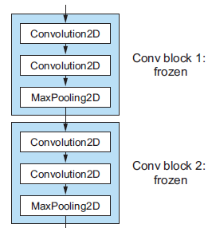
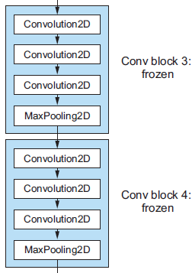
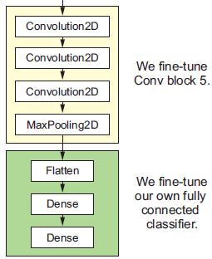
ADVANCED TOPICS · TRANSFER LEARNING
Fine-tuning VGG16
Unfreeze the last conv block and let backprop adapt those kernels to YOUR small dataset.
OPIM 5509 · Introduction to Deep Learning
22
Notes:
M3.3 preview.

Slide 23
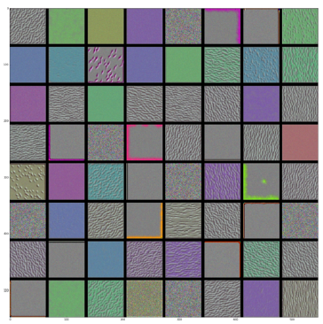
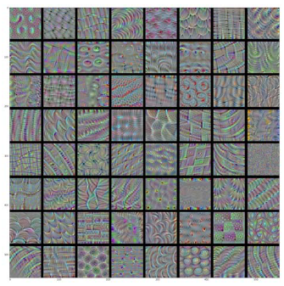
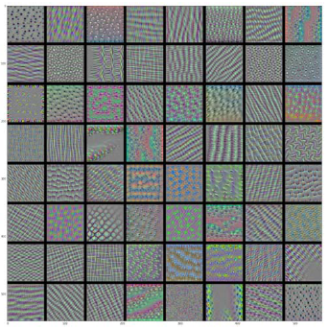
ADVANCED TOPICS · TRANSFER LEARNING
Kernels from VGG16 - amazing!
Block 1: general textures, common to every problem
Block 2: patterns start to specialize
Block 4: textures specific to YOUR problem
OPIM 5509 · Introduction to Deep Learning
23
Notes:
General -> specific as you go deeper. This is why transfer learning works.

Slide 24
MODULE 3.1 · RECAP
Five things to remember
1
Images are just numbers - B&W is one channel, RGB is three
2
Convolution = LIGHT downsampling; kernels are LEARNED, and each filter is an M x N x L brick
3
Pooling = AGGRESSIVE downsampling; no overlap, zero trainable parameters
4
ConvNets build their own features: edges -> textures -> parts -> prediction (and they're spatially invariant)
5
Conv2D parms = ((M · N · L) + B) · F - next up: use it to rebuild model.summary() by hand
Notes:
Close the theory videos here; the math walkthrough continues in the next deck.

